Slide 1

A Project Presentation On
Block-Chain Based
Secure Notarization System
BBSNS — A Zero-Trust Platform for Digital Notarization
Adhude Ganesh Sanjay [B400580365]
Mate Shubham Vilas [B400580398]
Shaikh Humera Ibrahim [B400580414]
Shivale Bhakti Bhagwan [B400580419]
Project Guide: Mrs. Riya B. Shikare
Department of Information Technology
Matoshri College of Engineering & Research Centre, Nashik
SAVITRIBAI PHULE PUNE UNIVERSITY 2025-2026

Slide 2
📋 Project Overview
What is BBSNS?
BBSNS is a full-stack, enterprise-grade decentralized platform that digitizes the traditional notary system. It replaces paper-based trust with immutable cryptographic proof by combining biometric identity, gasless blockchain signatures, cloud document storage, and multi-signature governance on BNB Smart Chain.
❌ The Problem
✅ Our Solution
🎯 Key Objective
Paper-based notarization is slow & fraud-prone
Forged documents are hard to detect
No public verification mechanism
Manual processes lack auditability
SHA-256 document fingerprinting on blockchain
Biometric + wallet identity verification
Public hash-based document verification
Immutable on-chain audit trail
Zero-trust architecture end-to-end
Gasless EIP-712 signatures for non-technical users
Multi-sig governance for system parameters
Self-healing background workers for reliability

Slide 3
⚙️ Technology Stack
Layer
Technology
Purpose
Web Client
Next.js 14 / React
Server-side rendered portal for Document Owners
Desktop Client
Electron
Isolated, sandboxed Notary console
Core API
Node.js / Express.js
Asynchronous orchestration & cryptographic relay
Smart Contracts
Solidity / Hardhat
Immutable, decentralized source of truth
Blockchain
BNB Smart Chain (BSC Testnet)
Multi-sig governance & token economy
Database
PostgreSQL
Fast relational querying & state caching
Blob Storage
AWS S3
Immutable document vaulting with Object Lock
Background Jobs
Custom Node Workers
Self-healing state reconciliation & cleanup

Slide 4
🏗️ System Architecture
🌐 FRONTEND LAYER
☁️ APPLICATION LAYER
⛓️ BLOCKCHAIN LAYER
🗄️ DATA LAYER
Next.js Web Portal (Owner)
Core API (Node/Express)
Token Contract
PostgreSQL (documents, users)
Electron Desktop Console (Notary)
Background Workers
Registry Contract
Upload Intents Table
AWS S3 Storage
Multi-Sig Governor
Audit Logs

Slide 5
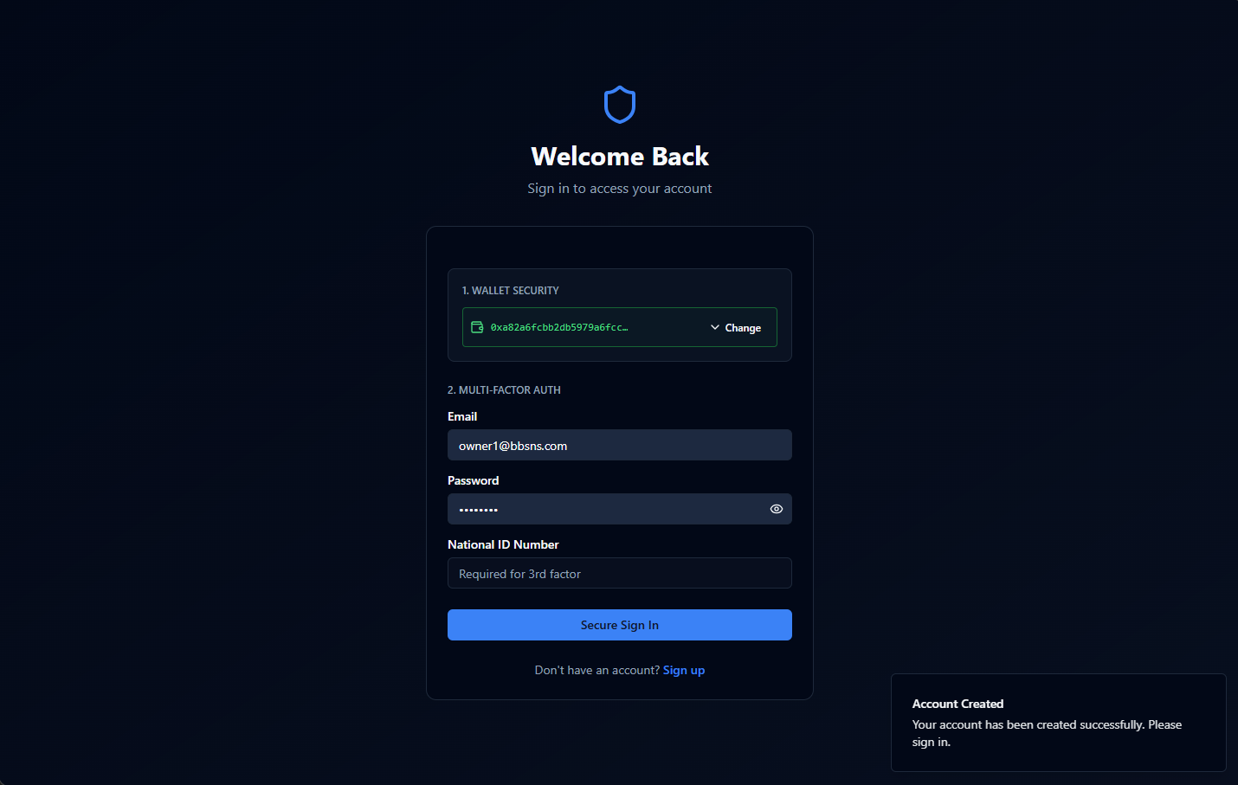
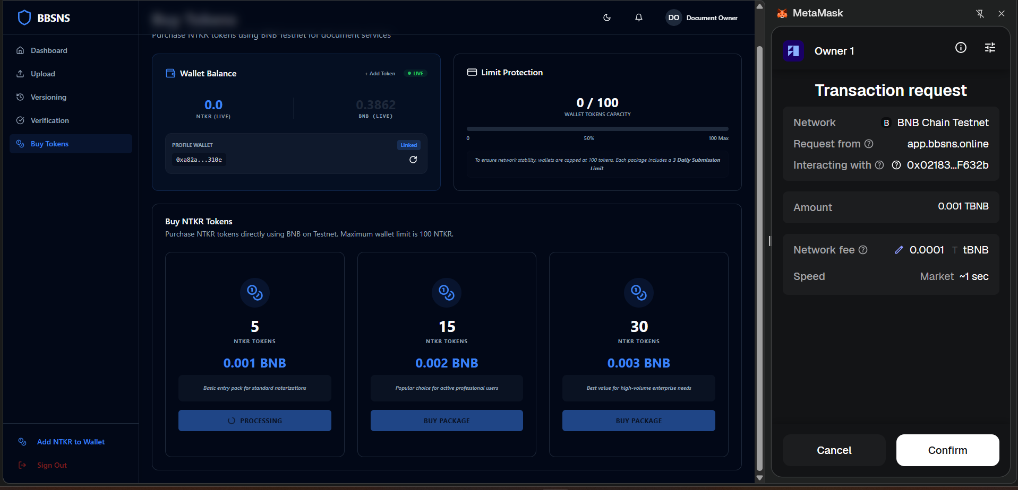


👤 Document Owner Flow
1️⃣ Register with Email + National ID + MetaMask Wallet
2️⃣ Sign up biometric check (face recognition)
3️⃣ Wallet binding: Cryptographic signature for identity
4️⃣ Log in with 3-factor auth (Email + Password + National ID + Wallet)
5️⃣ Upload document → system hashes it locally (SHA-256)
6️⃣ Buy NTKR tokens → burn tokens to pay notarization fee
7️⃣ Track document status → Receive verifiable PDF certificate
Sign-up Completed
Buying NTKR Tokens
Owner Dashboard
Notarization Certificate

Slide 6


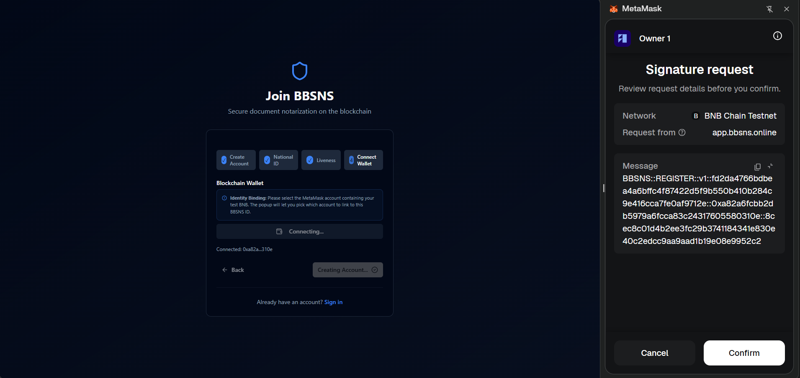
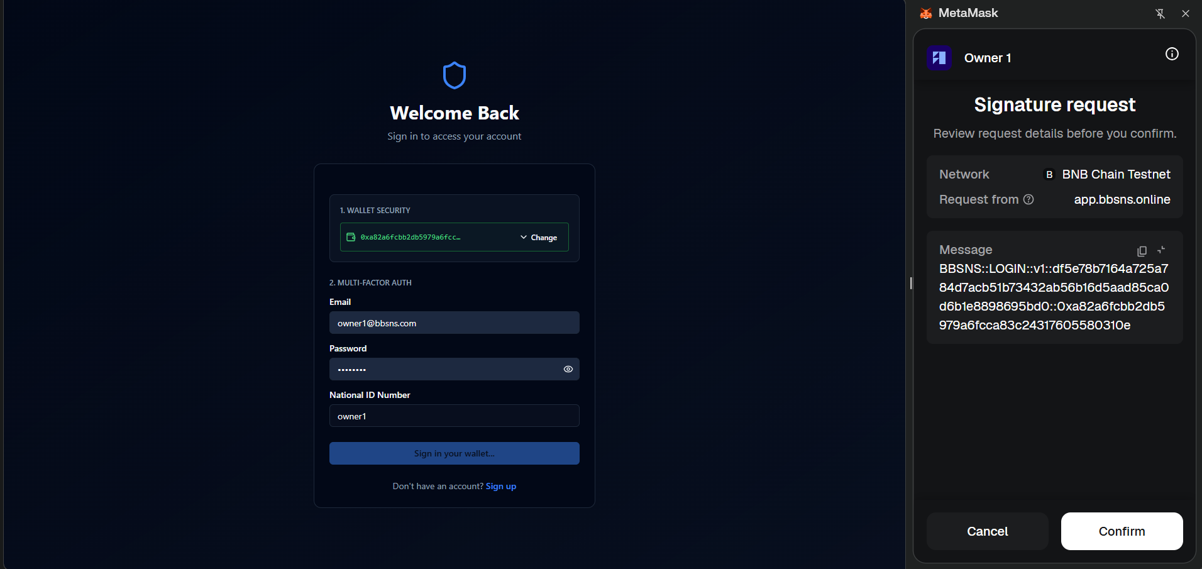
🔐 Secure Registration & Identity Verification
Step 3: Biometric Face Check
Step 4: Wallet Binding
Step 4b: Signature Confirmation
Sign-In: Cryptographic Signature

Slide 7

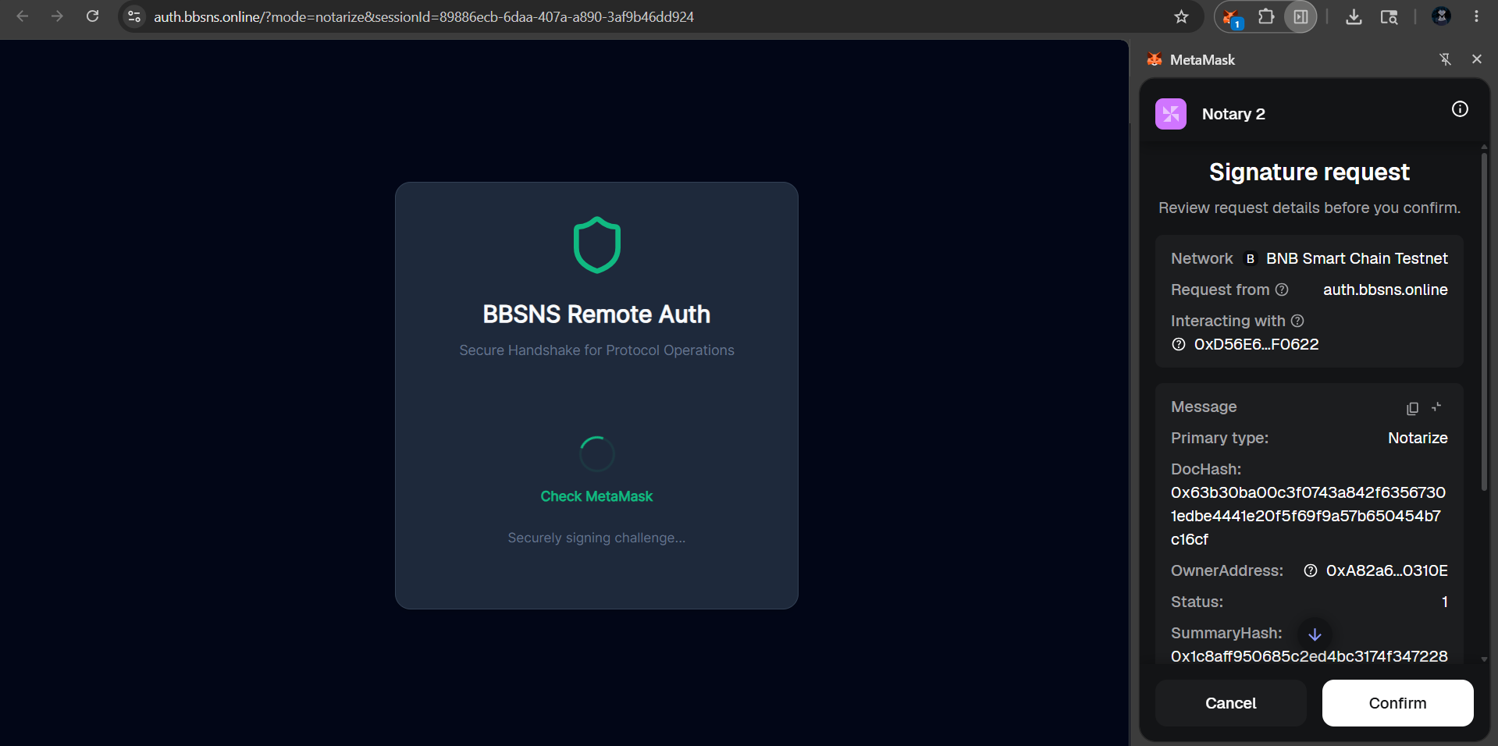
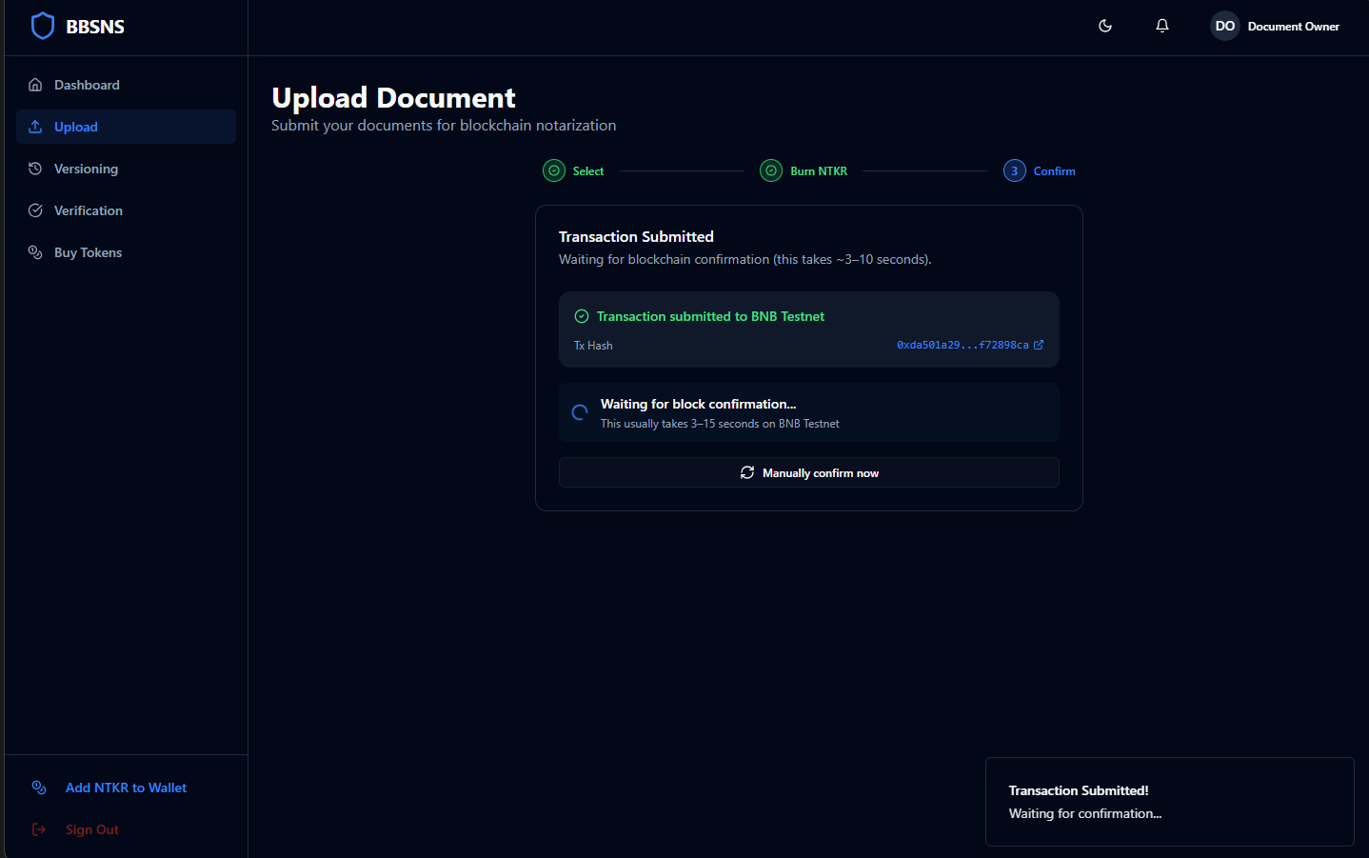
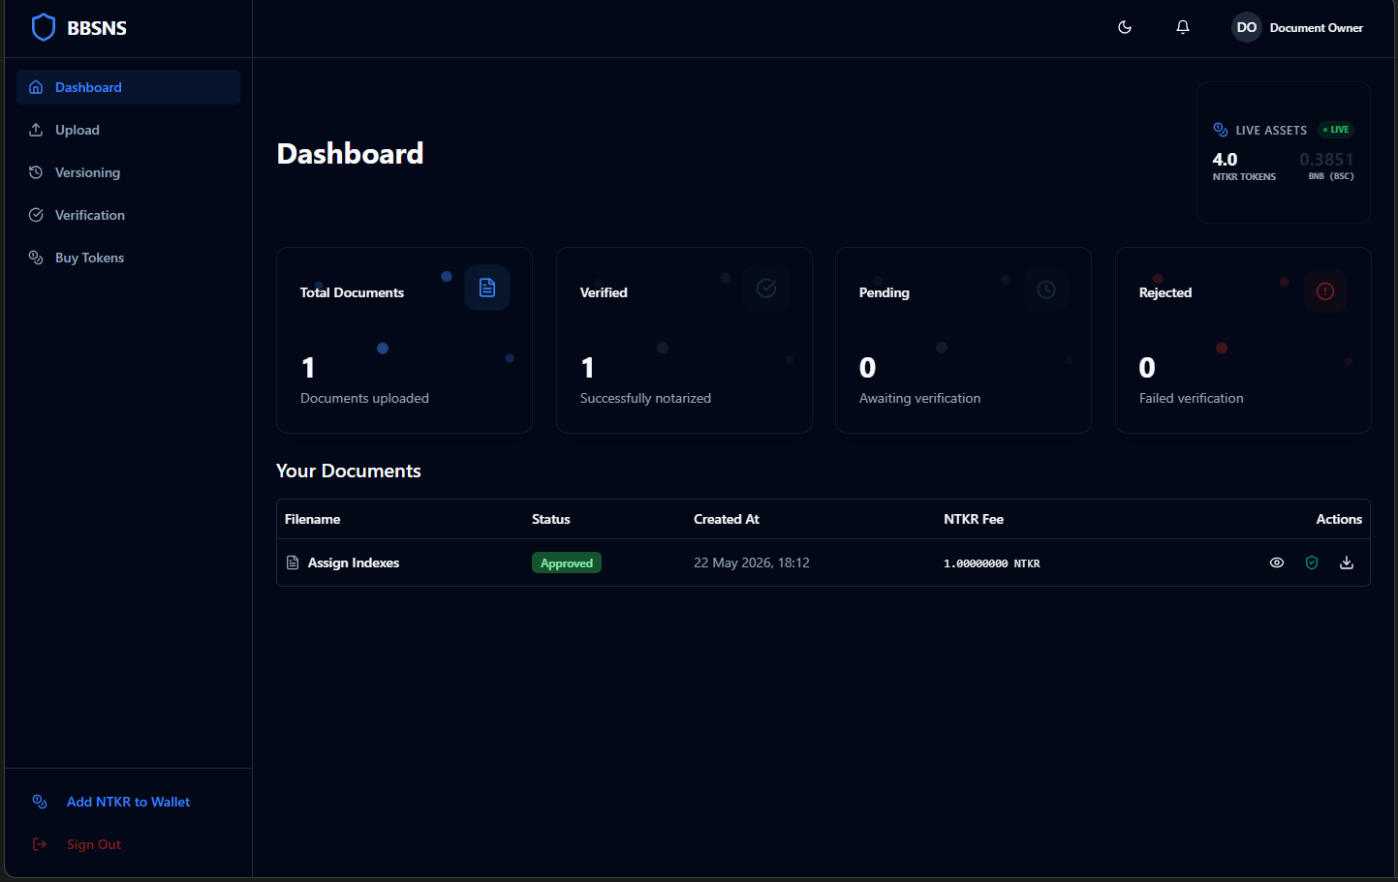
📤 Document Upload & NTKR Token Economy
Upload + NTKR Burn Process
Notarize & Pay NTKR
NTKR Burn Tx Confirmed
Document Status: Approved

Slide 8
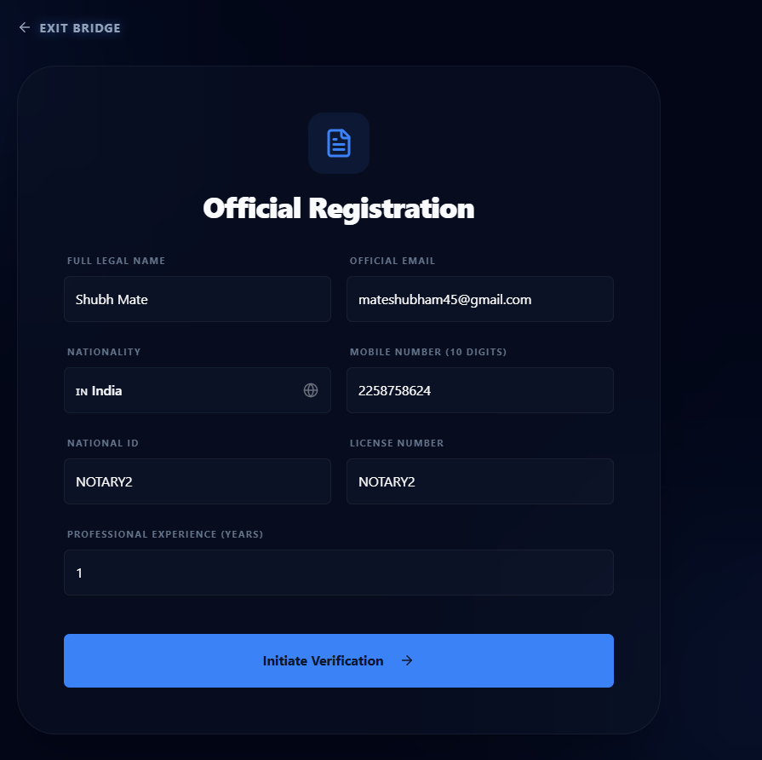
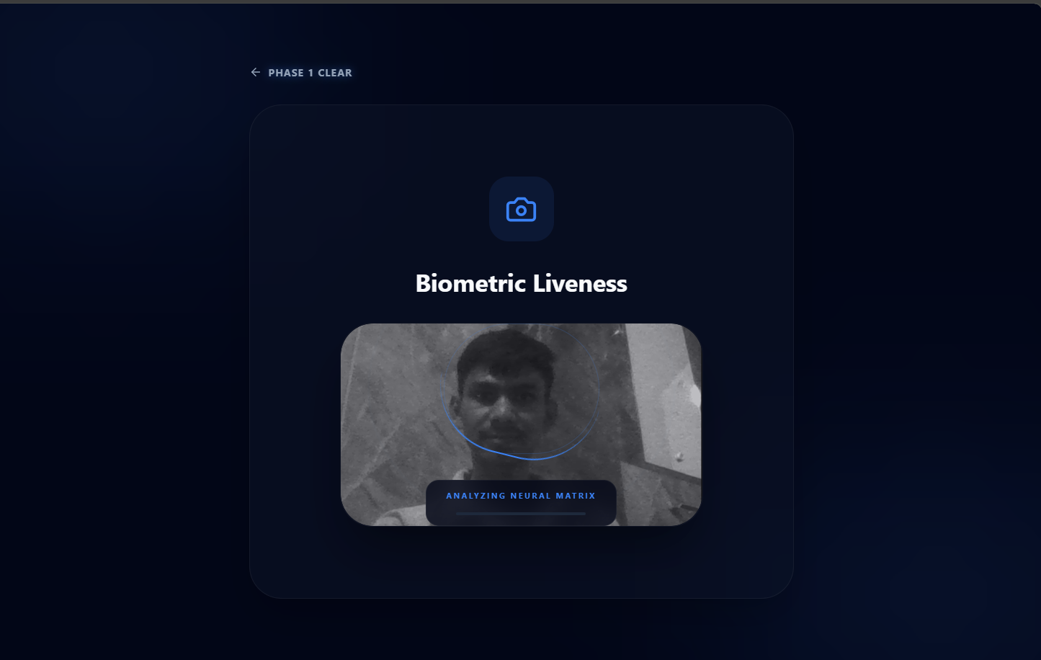
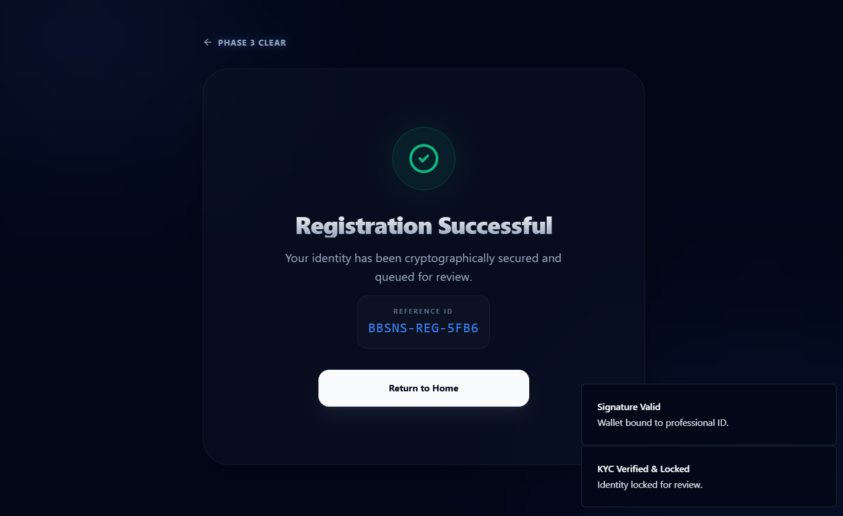
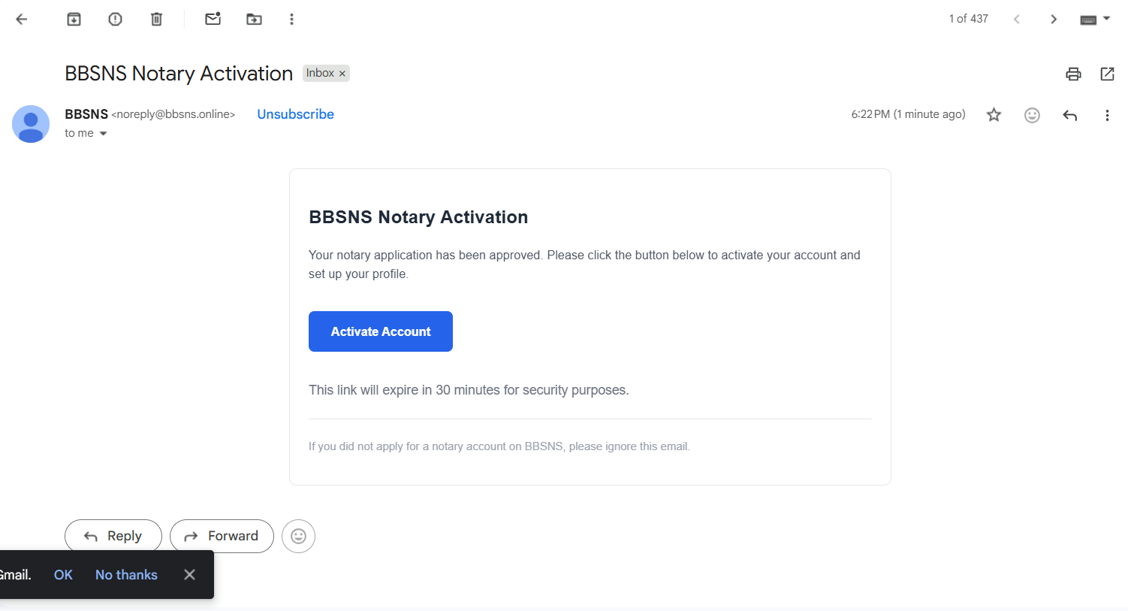
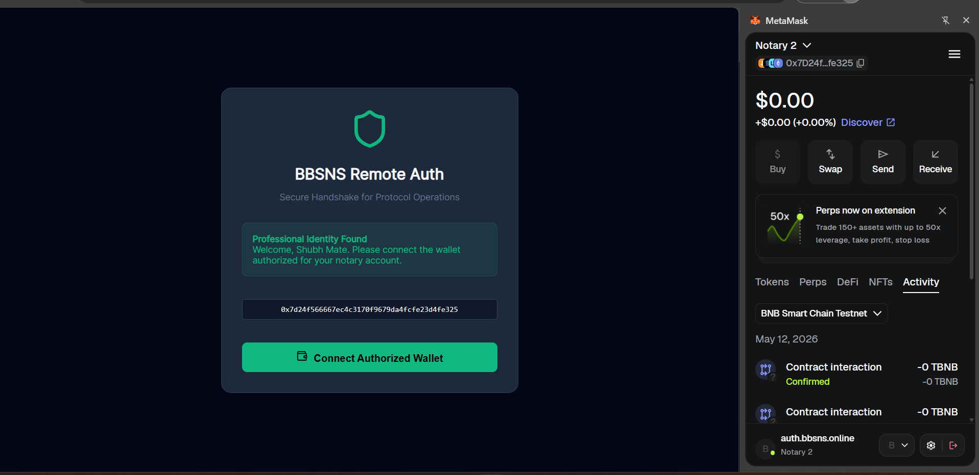
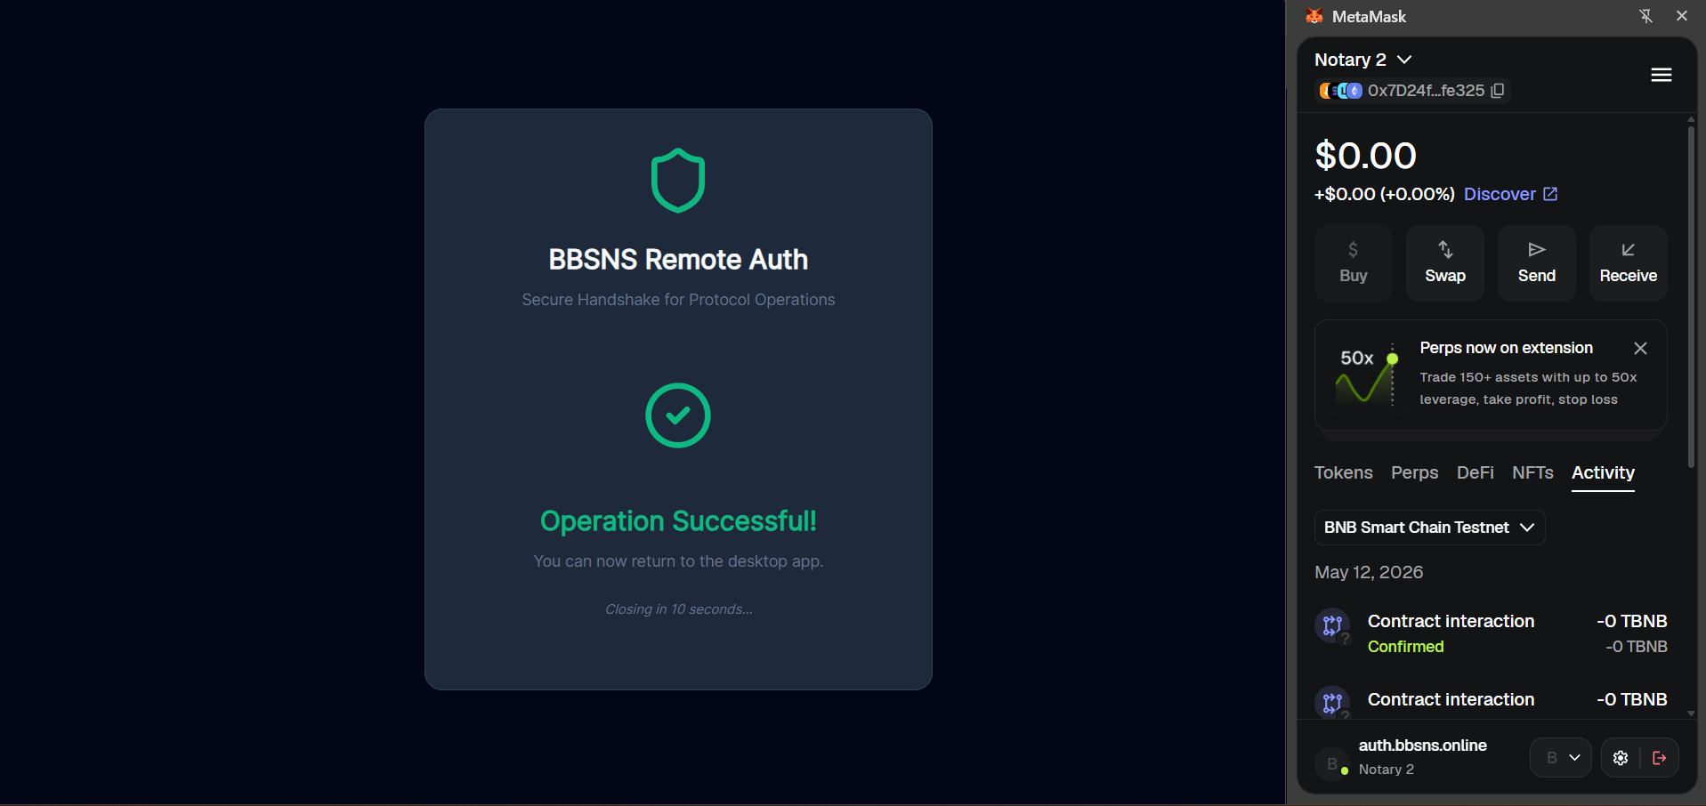
📝 Notary Registration & Account Activation
Phase 1: Basic Info
Phase 2: Document Upload
Phase 3: Wallet Binding
Activation Email Received
Wallet Confirmation
Account Activated

Slide 9
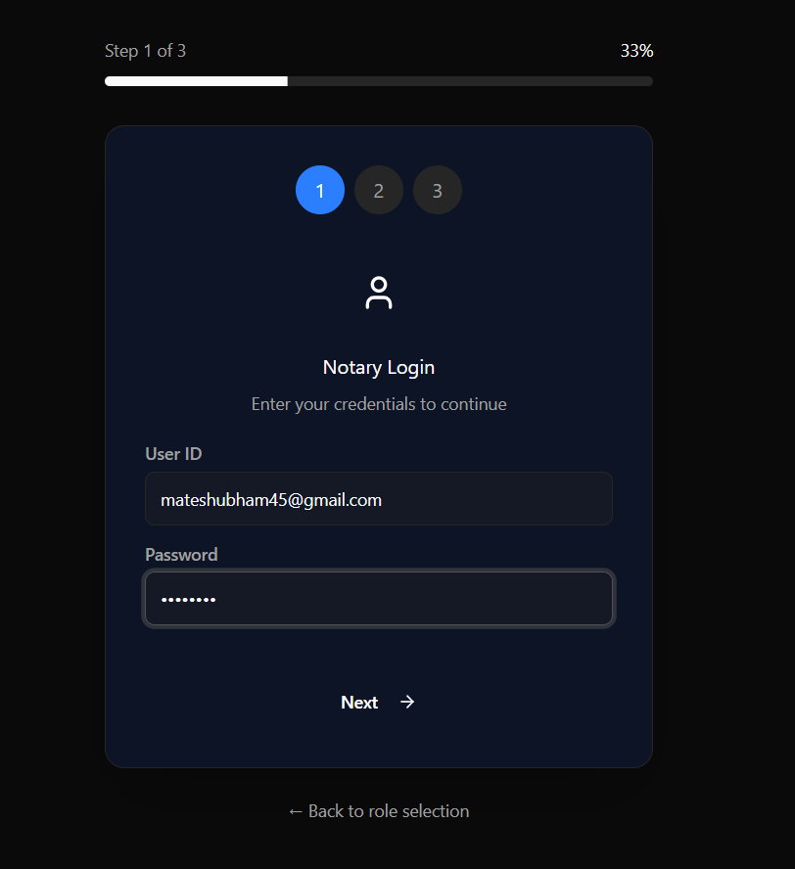
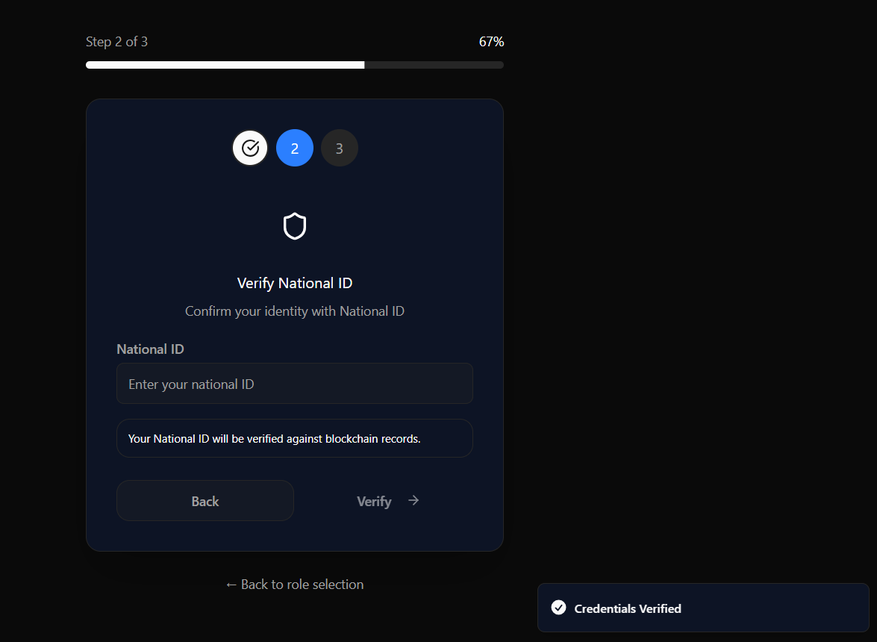
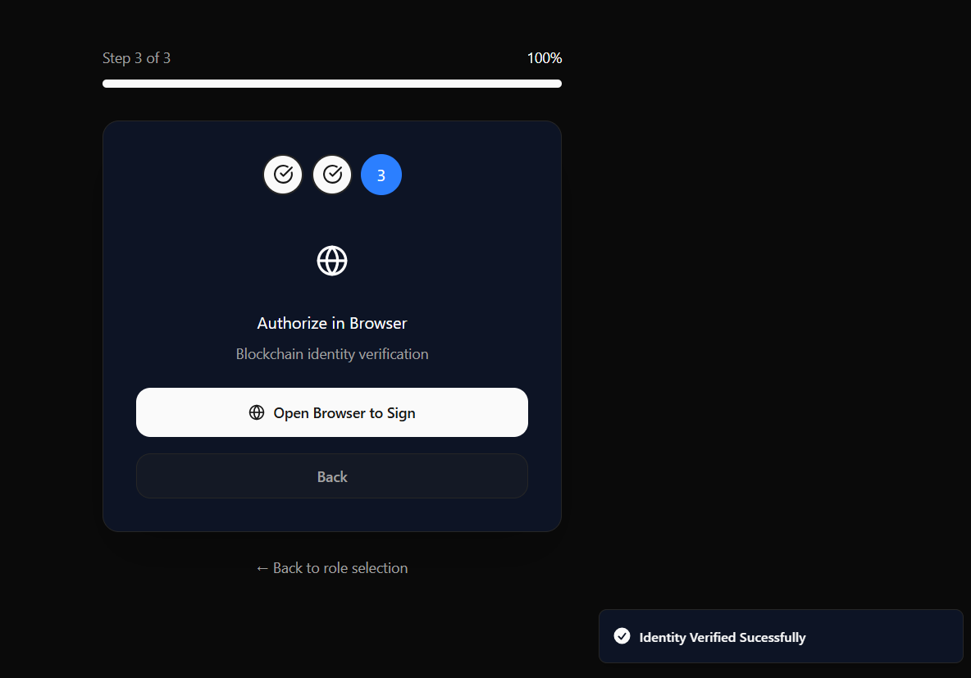
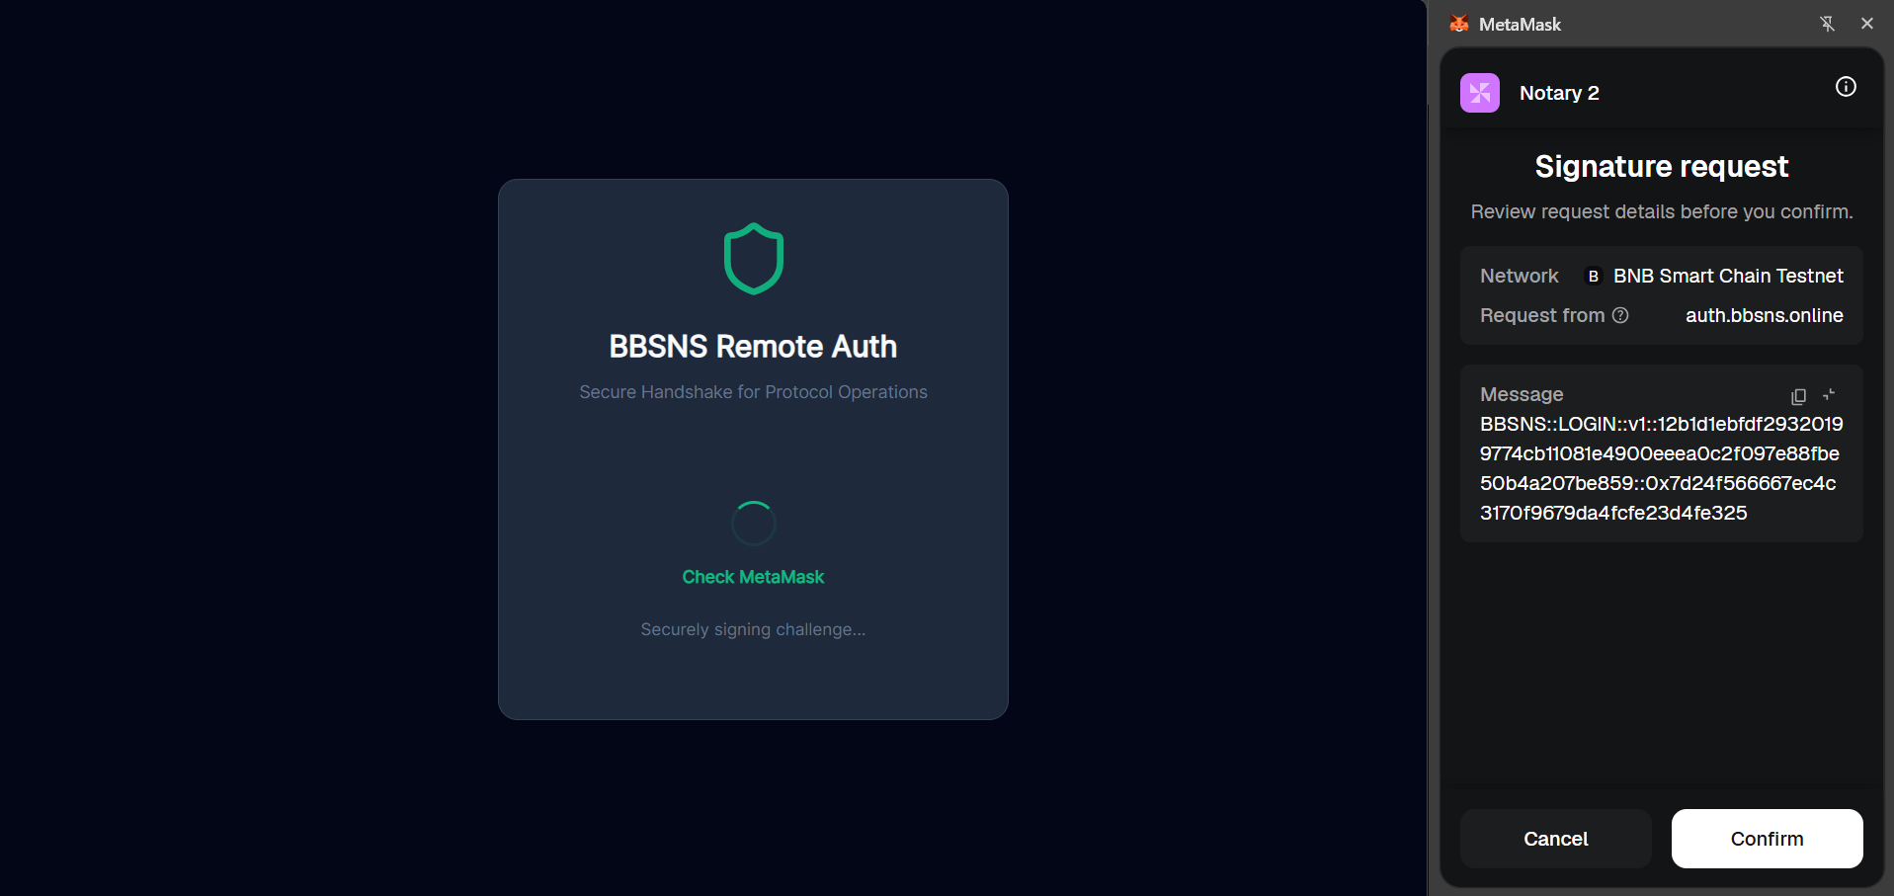
🔑 Notary Secure Login (Multi-Step Authentication)
Step 1: Credentials
Step 2: 2FA
Step 3.1: Biometric Verify
Step 3.2: Wallet Signature

Slide 10


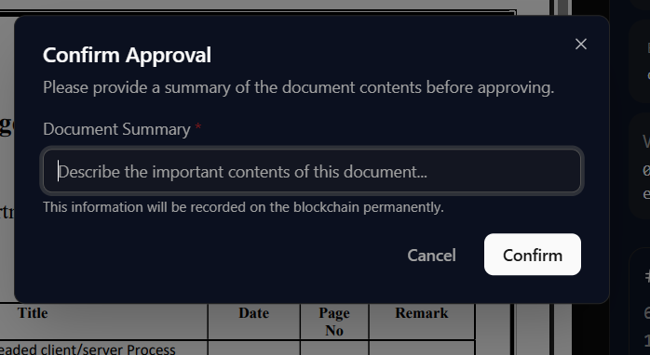

✅ Notary Dashboard & Notarization Workflow
Pending Documents Queue
Review Document Details
Process: Document Approval Info
Document Approved View

Slide 11
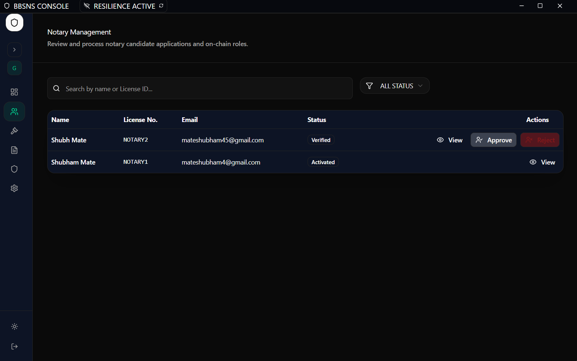

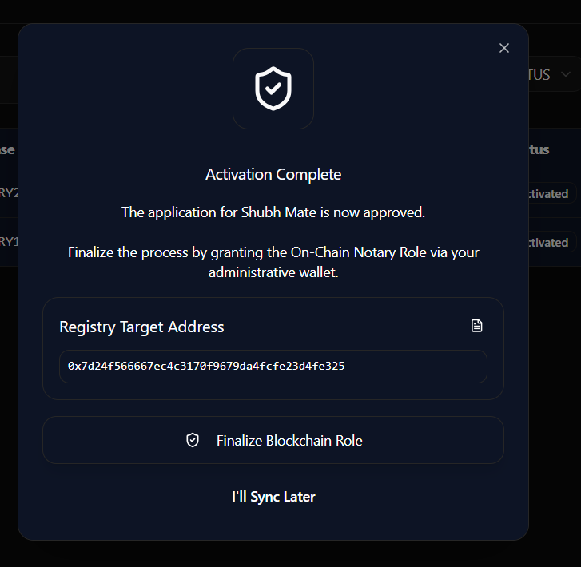

🛡️ Admin Control Panel — Notary Governance
Pending Notary Applications
Applicant Detail Review
On-Chain Role Assignment
Role Confirmed On-Chain

Slide 12
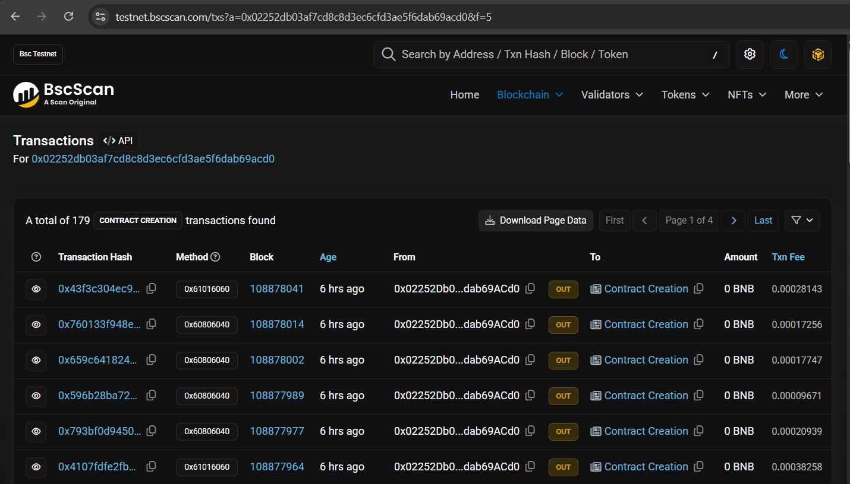

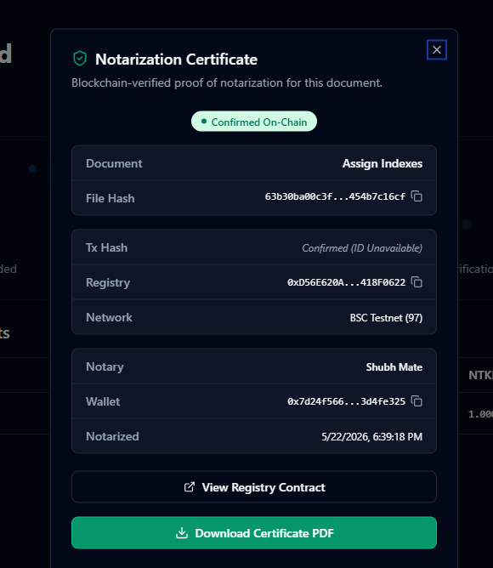
⛓️ Blockchain Evidence & Public Verification
Smart Contract Transactions on BscScan
SHA-256 Hash Public Verification
Verifiable Certificate of Notarization
Digital Certificate Issued

Slide 13
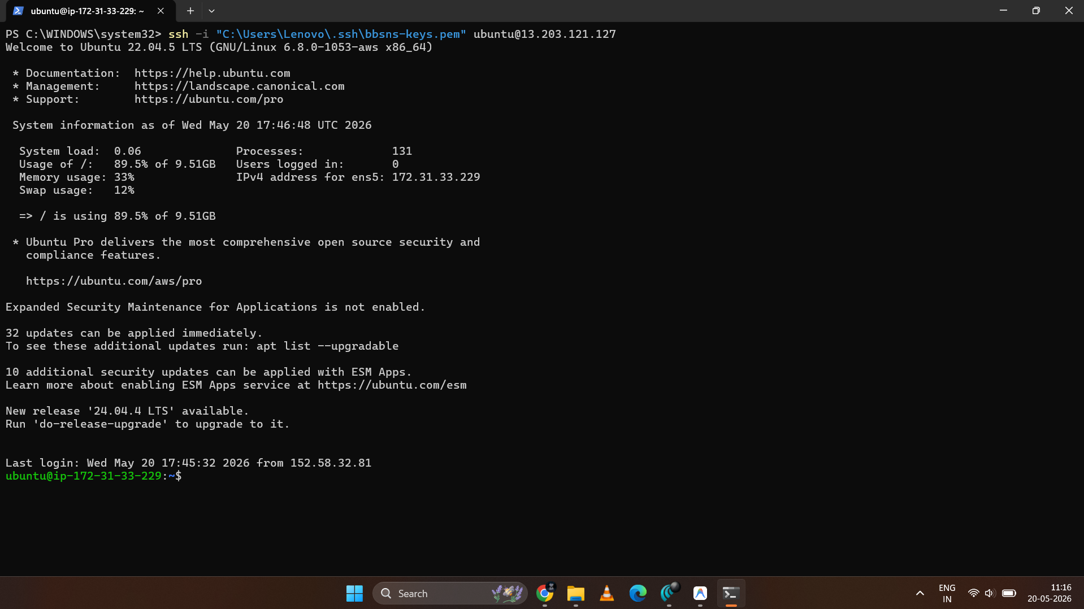

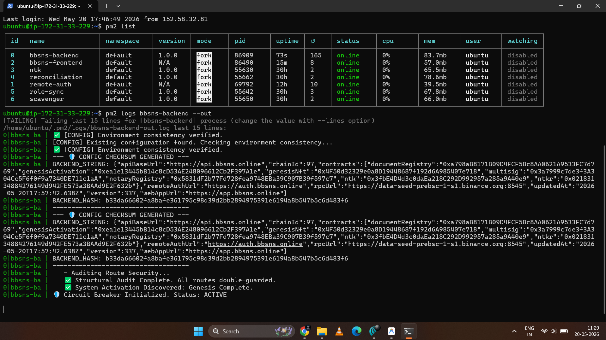
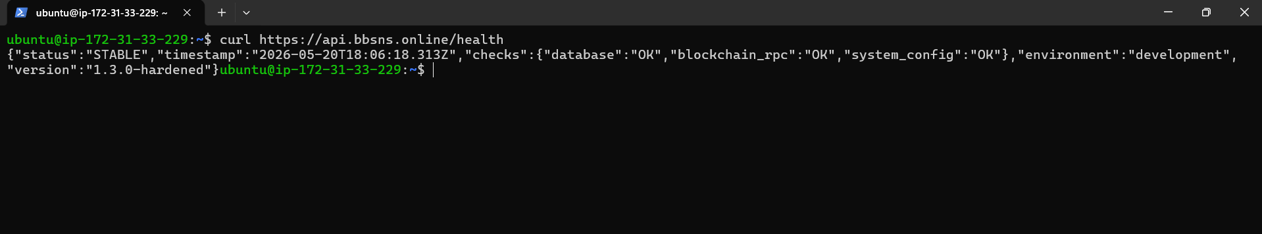
☁️ Cloud Deployment & Infrastructure Proof
AWS EC2 SSH Connection (Ubuntu 22.04)
Running Processes (PM2 Cluster)
Live Backend Runtime Logs
API Health Check Response

Slide 14
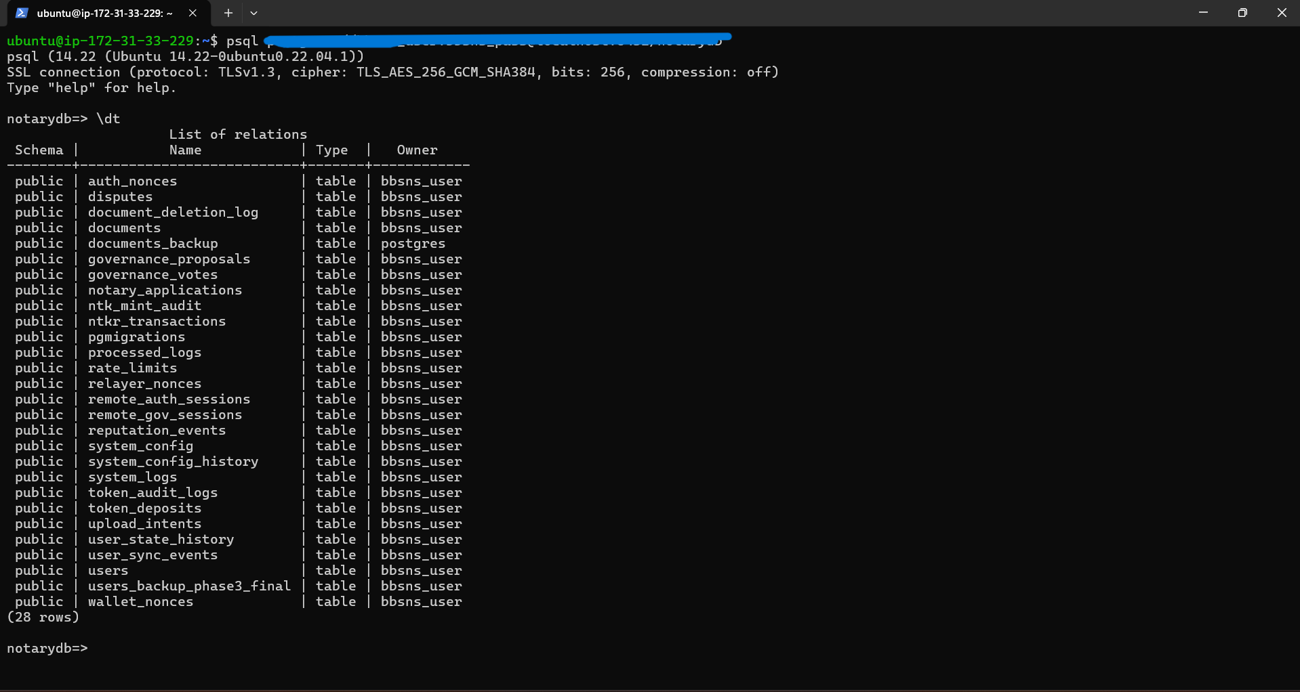
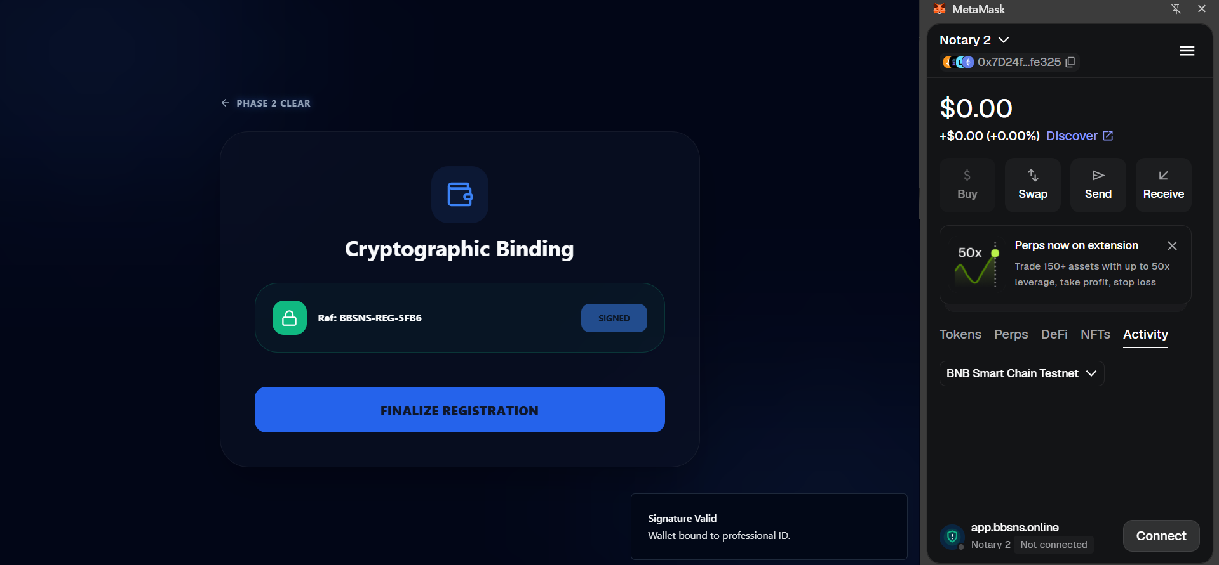
🗄️ Database Schema & Security Architecture
SHA-256 Document Sealing
EIP-712 ECDSA Signatures
Documents hashed locally before upload
Only hash stored on-chain, never the file
Off-chain structured data signing
Gasless relay to blockchain via API
Zero-Trust Middleware
AWS S3 Object Lock
Every API route verified server-side
wallet_address recovery from signature
Immutable document storage
UUID-based S3 key — no filename exposure
PostgreSQL: Database Relations
Key Tables: users • documents • upload_intents • notary_applications • audit_logs
Notary Application in DB
Approved Document Record

Slide 15
🔒 Security Architecture — Zero-Trust Design
3-Factor Authentication (Owners)
Biometric Identity Lock (Notaries)
Immutable Blockchain Evidence
Email + Password
National ID (normalized)
MetaMask Wallet Signature (EIP-712)
Face recognition at every login
Biometric state stored separately
Cannot login without passing check
SHA-256 hash sealed on BNB Smart Chain
Smart contract cannot be altered post-deploy
BscScan public explorer audit trail
Multi-Sig Governance
Document Storage Security
Background Worker Integrity
3-of-N keys required for role changes
No single admin has full control
On-chain Notary role assignment voted
S3 pre-signed URLs (time-limited)
UUID-based keys — filenames never exposed
Object Lock prevents deletion
Scavenger worker reconciles DB vs chain
Promotes intents only on confirmed payment
No manual intervention required

Slide 16
🔄 End-to-End Document Lifecycle State Machine
📤
☁️
💰
⏳
✍️
⛓️
Upload
Initiated
Storage
Secured
Payment
Verified
Awaiting
Notary
Signing
In Progress
On-Chain
Finalized
Owner uploads document. SHA-256 hash generated locally. Upload intent created in DB.
File transferred to AWS S3 via pre-signed URL. UUID-based storage key assigned.
NTKR token payment verified on-chain. Intent locked. Awaiting notary assignment.
Document visible in Notary console. Notary reviews PDF and metadata securely.
Notary signs EIP-712 payload off-chain. Signature relayed to smart contract.
Transaction confirmed on BNB Smart Chain. PDF certificate issued. Record immutable.

Slide 17
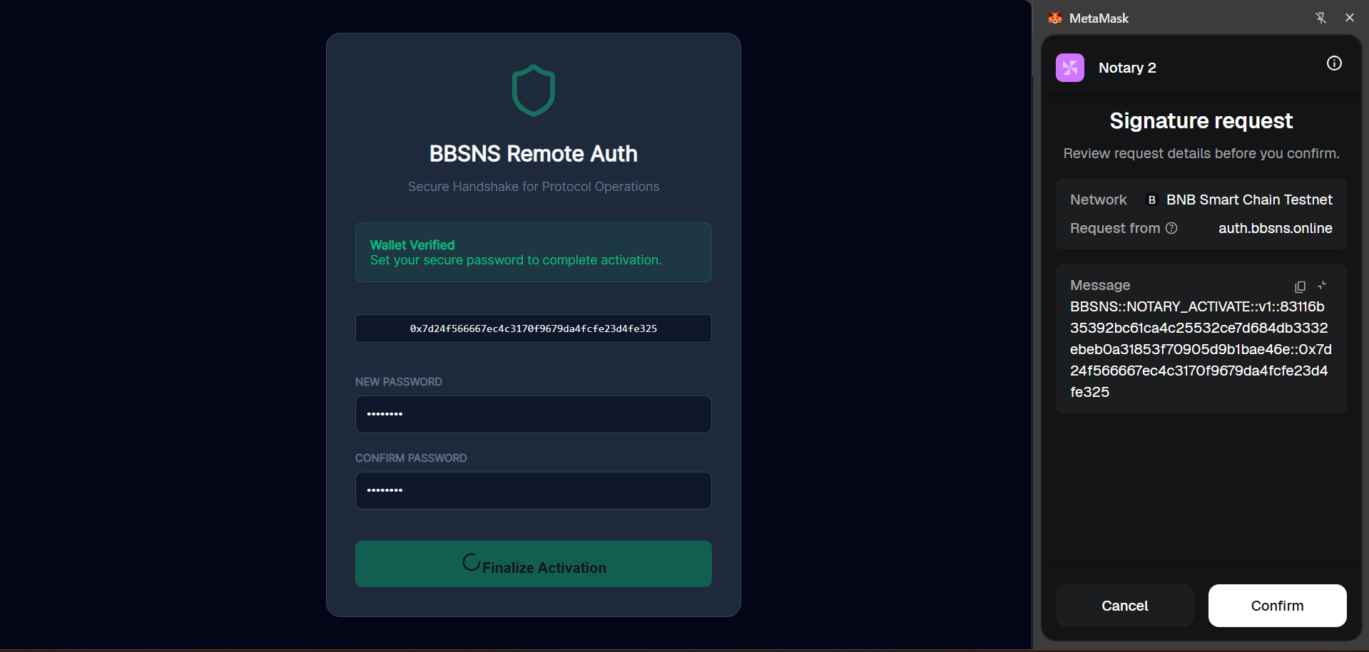
🧑‍⚖️ Notary Application & On-Chain Role Assignment Flow
Notary Application Submitted
Admin: On-Chain Role Assigned
Notary: Account Activation Screen
Notary: Activation Confirmed

Slide 18
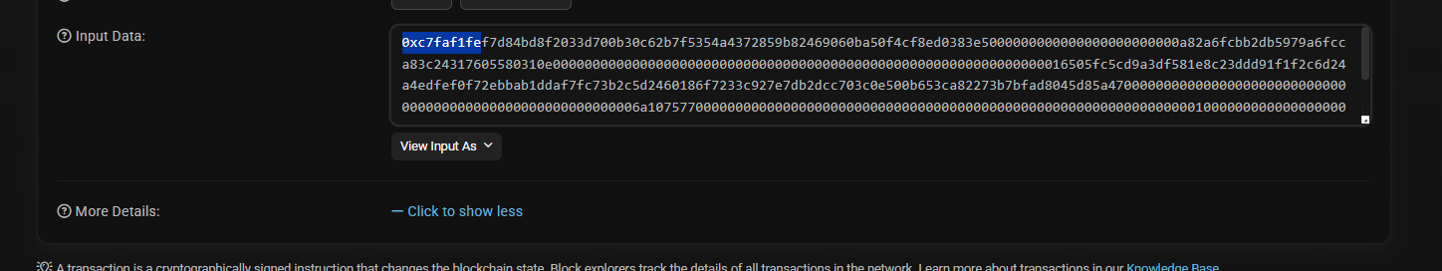
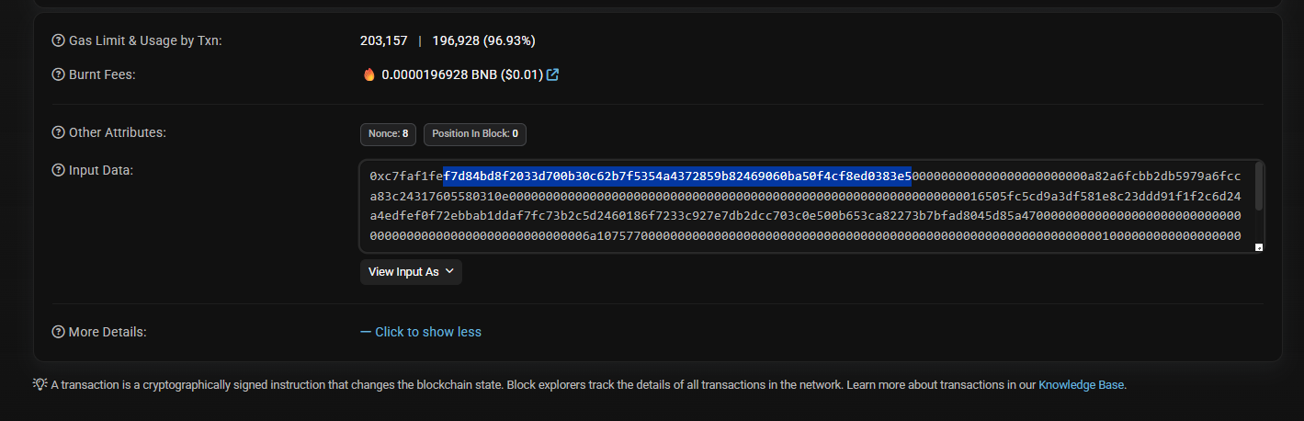
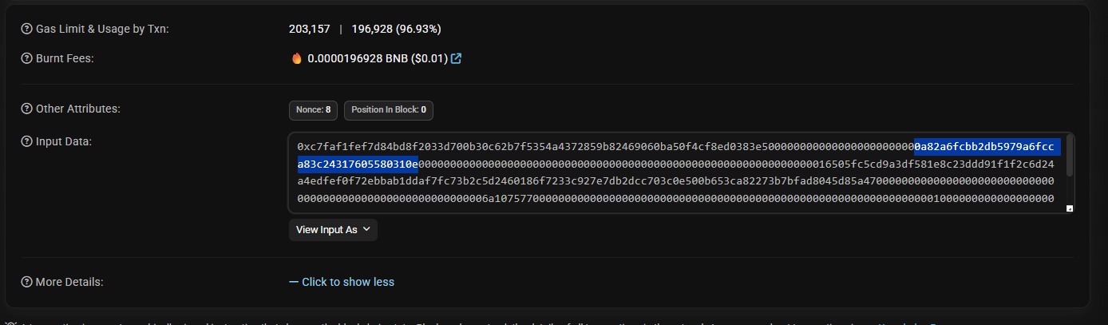
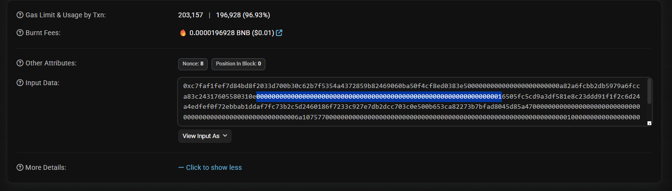
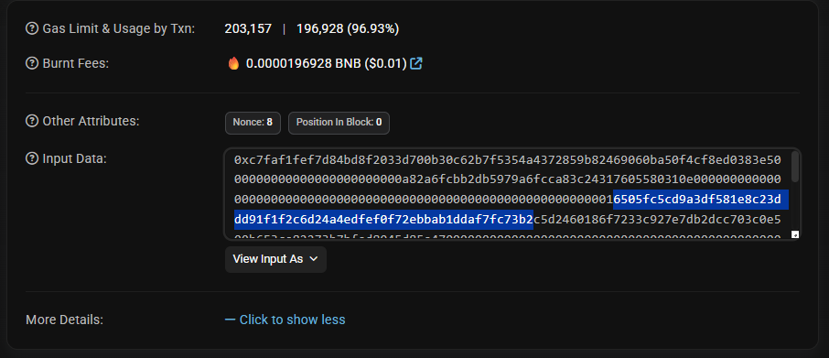
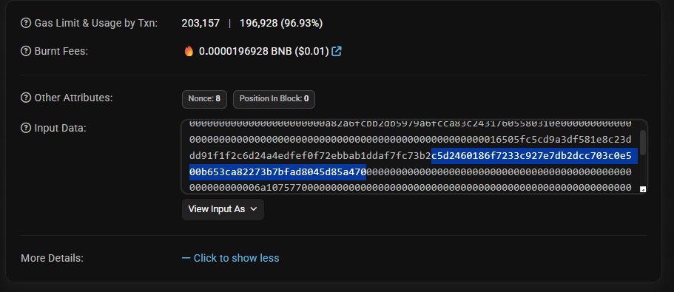
📜 After Notarization — On-Chain Transaction Evidence
On-Chain Tx Hash
Block Confirmation
Contract Interaction
Token Transfer Record
Hash Stored On-Chain
Finalization Event

Slide 19
✨ Key Features & Innovation Highlights
🔑
⛓️
💸
☁️
Zero-Trust Auth
On-Chain Finality
Gasless Signing
Secure Cloud Vault
3-factor auth with biometric + wallet binding — every actor cryptographically verified
Document hashes permanently sealed on BNB Smart Chain — immutable & publicly auditable
EIP-712 off-chain signatures relayed by API — non-technical users need no ETH for gas
AWS S3 with Object Lock — UUID-keyed storage, time-limited signed URLs, no filename exposure
🤖
🏛️
📋
📜
Self-Healing Workers
Multi-Sig Governance
Audit Trail
Verifiable Certificate
Background reconciliation workers auto-sync DB with blockchain — zero manual intervention
Decentralized admin control — critical role changes require consensus among governance keys
Every action generates an immutable forensic log — full compliance-grade accountability
PDF certificate with QR code — public verification via SHA-256 hash without trusting BBSNS

Slide 20
Thank You
Block-Chain Based Secure Notarization System — BBSNS
Adhude Ganesh Sanjay [B400580365] · Mate Shubham Vilas [B400580398]
Shaikh Humera Ibrahim [B400580414] · Shivale Bhakti Bhagwan [B400580419]
Guide: Mrs. Riya B. Shikare
Matoshri College of Engineering & Research Centre, Nashik | Department of Computer Engineering | 2025–26
app.bbsns.online

